Slide 1

Gulshan Kumar 223135
CSE(B)
Presentation on website

Slide 2
CONTENT
Source code of the website along with screenshot of webpages

Slide 3
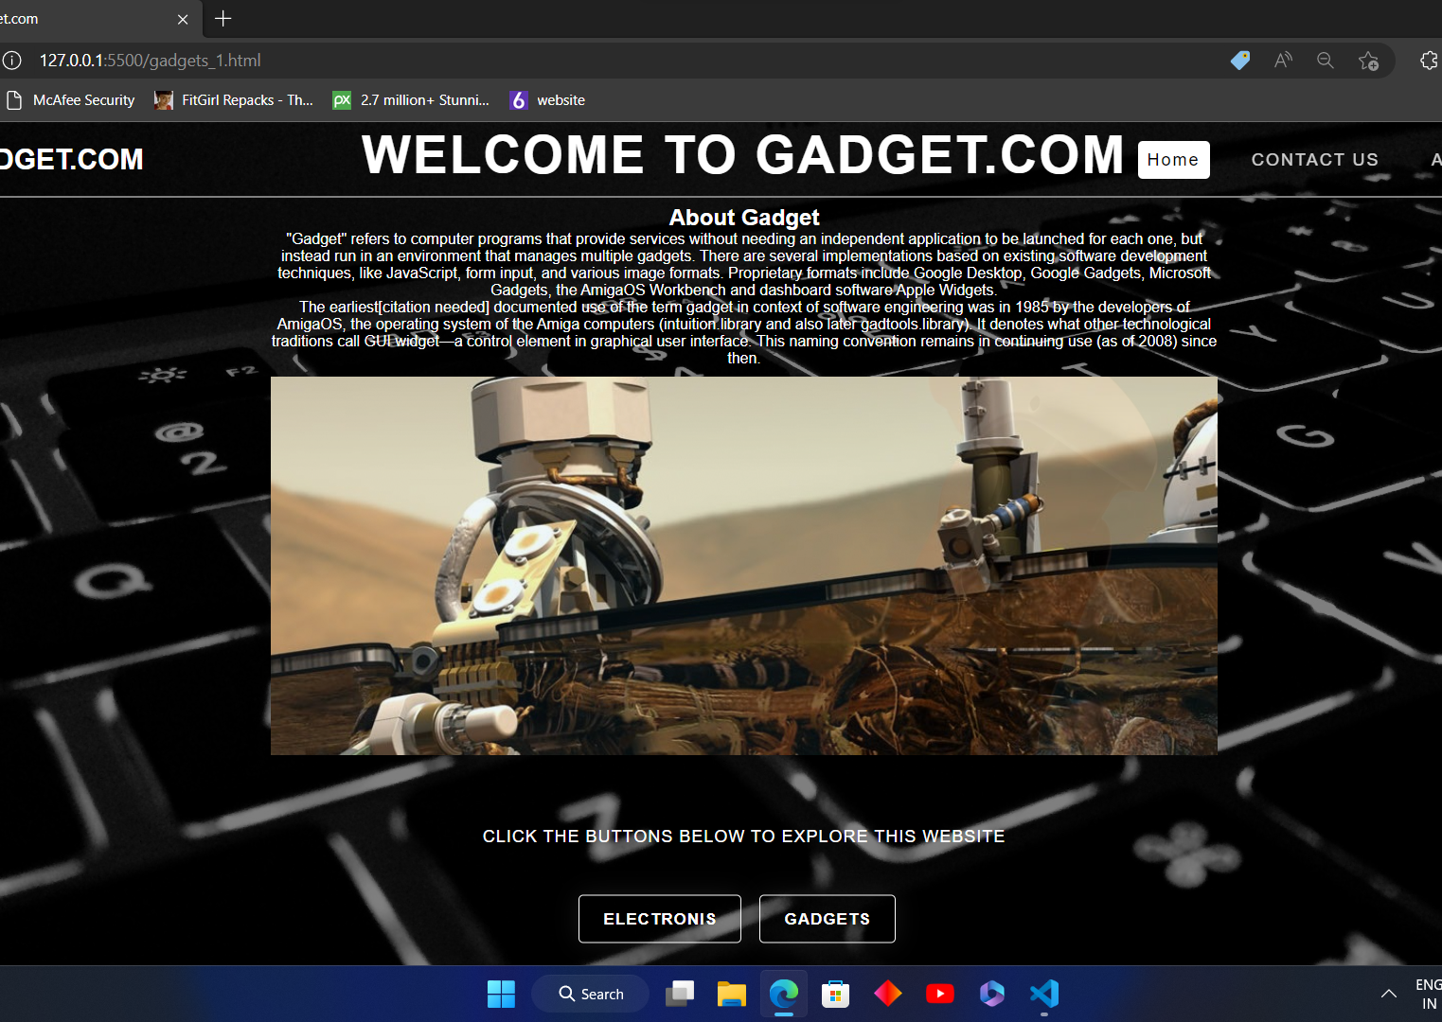
HOME PAGE OF WEBSITE
Home page of website contains links to CONTACT US , Electronics ,Gadgets

Slide 4
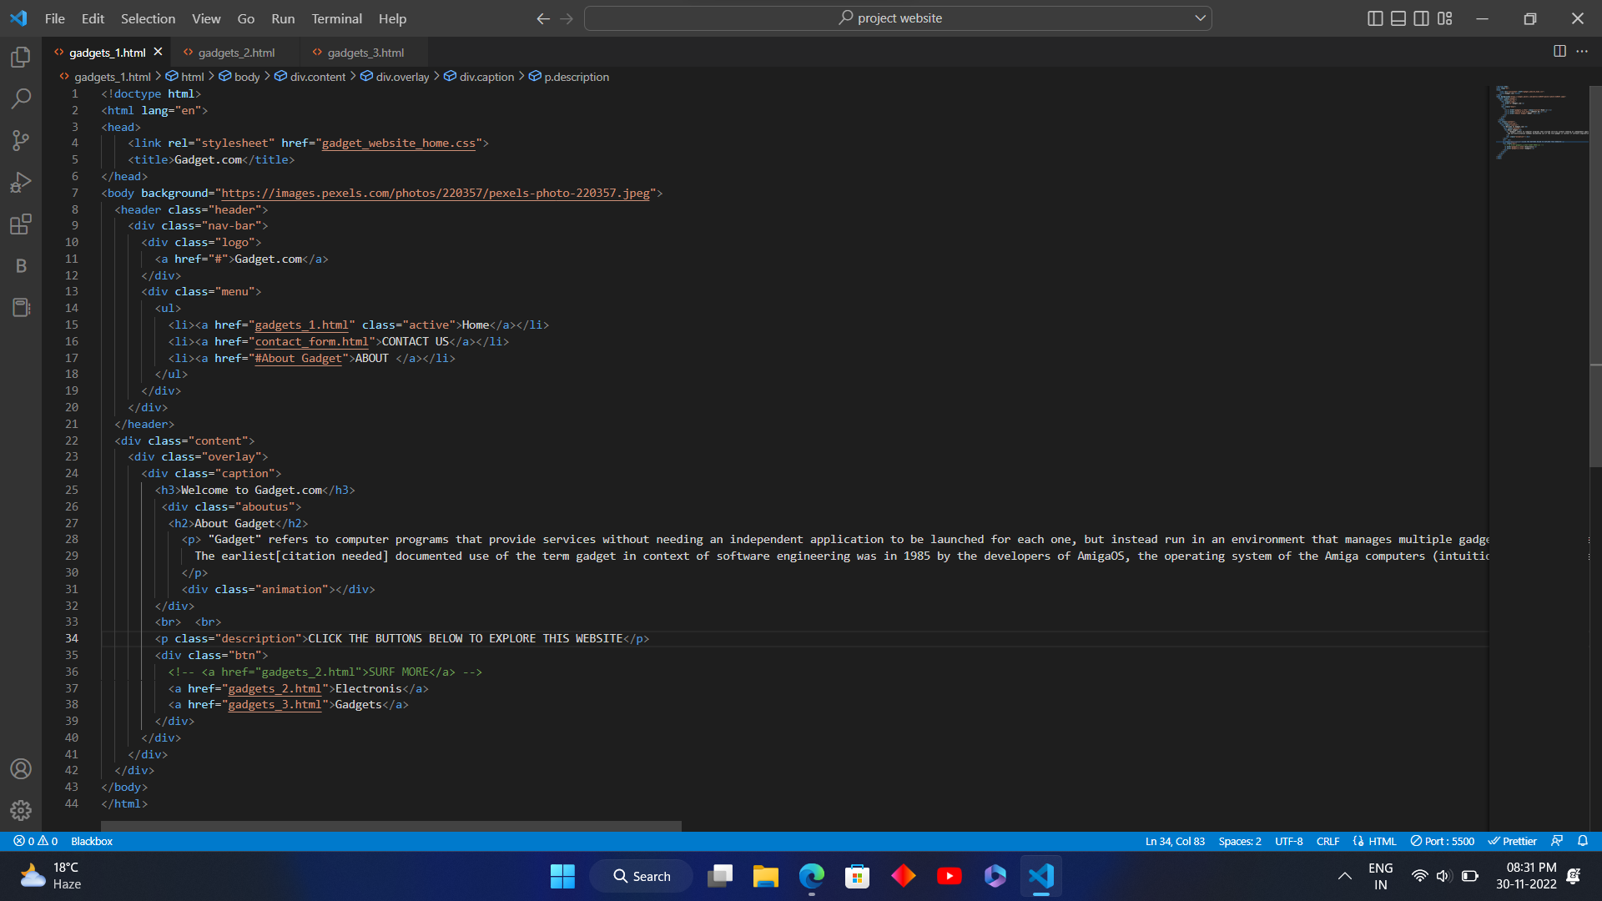
Source code of Home Page {html}

Slide 5
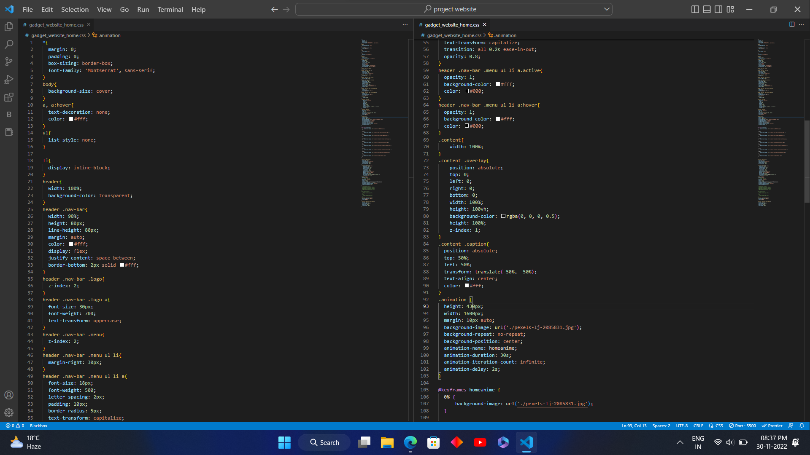
Source code of Home page {css 1}

Slide 6
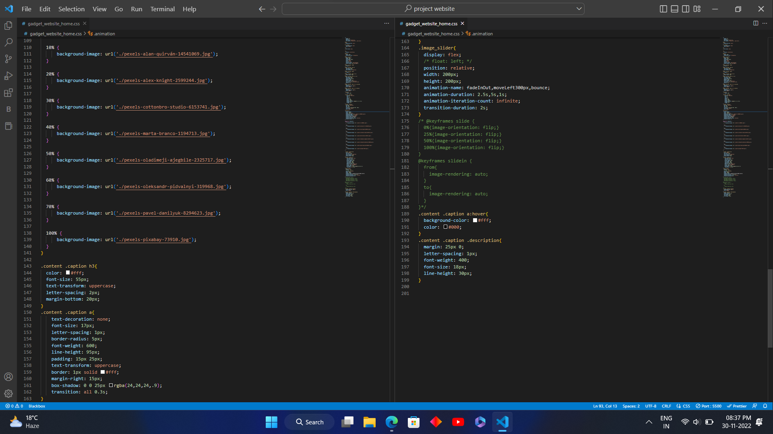
Source code of home page { css 2}

Slide 7
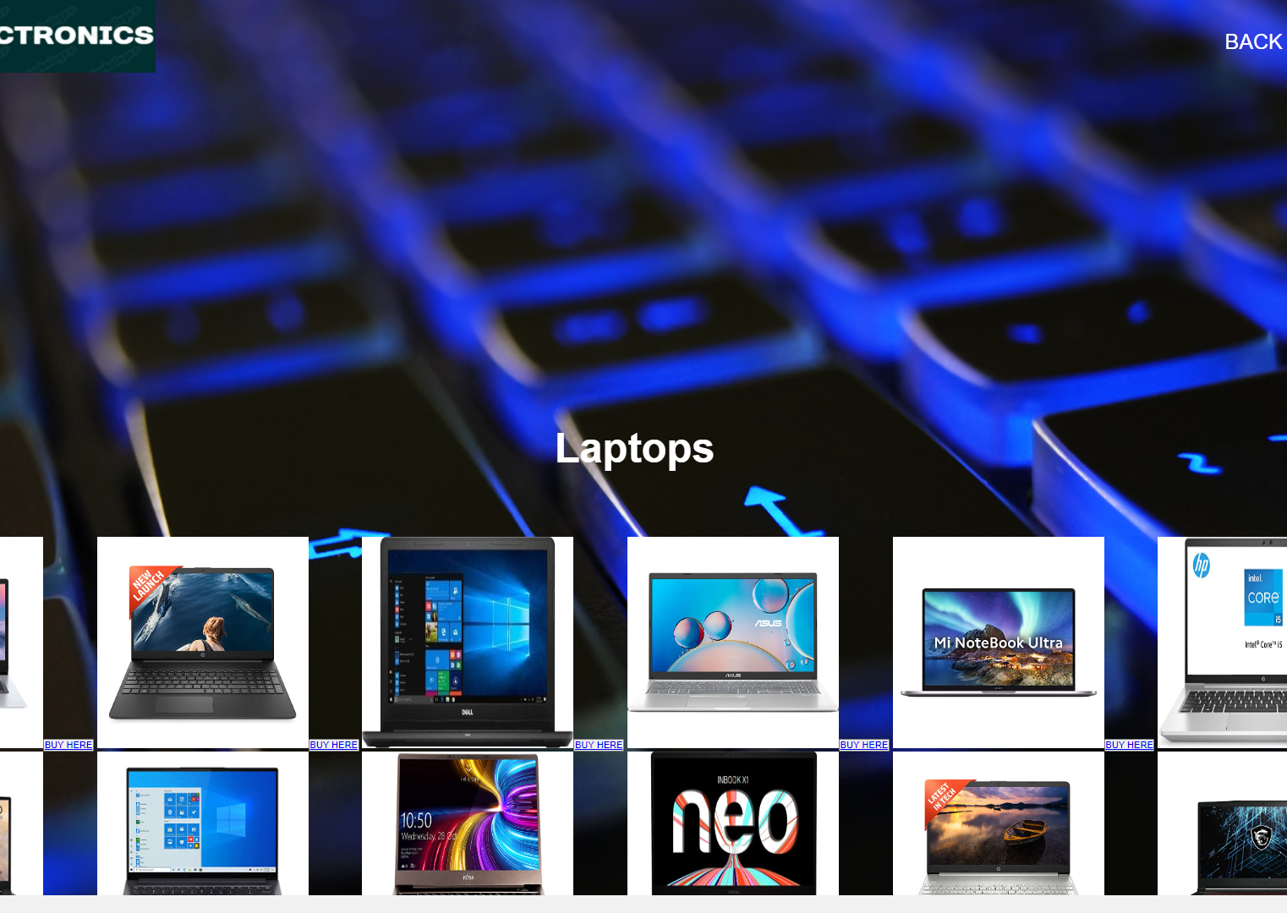
Electronics page
By clicking the electronics button on home page it will redirect to this webpage

Slide 8
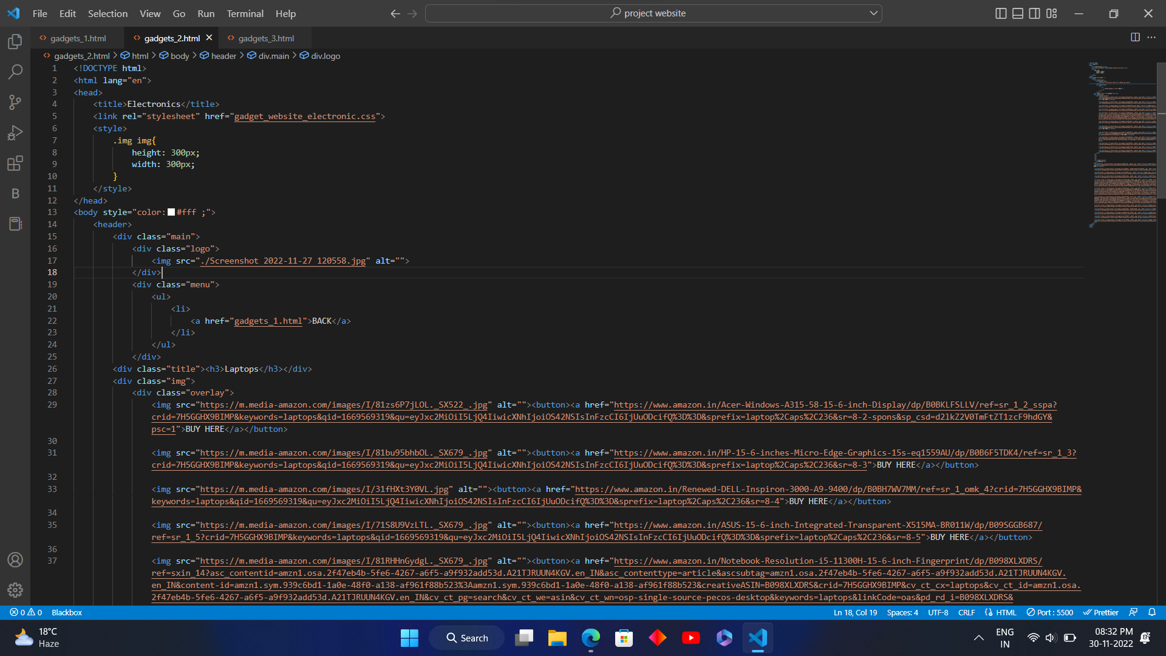
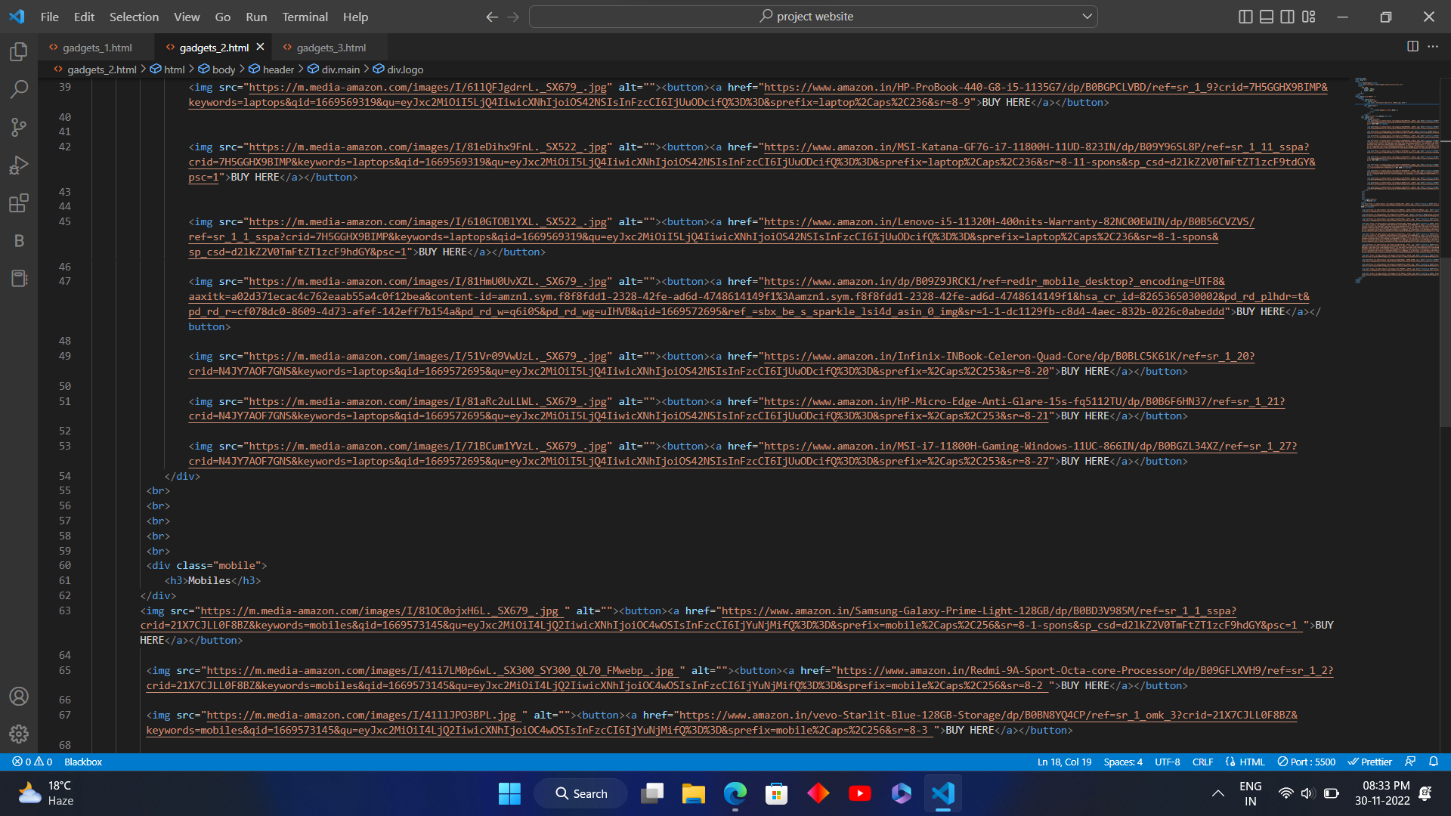
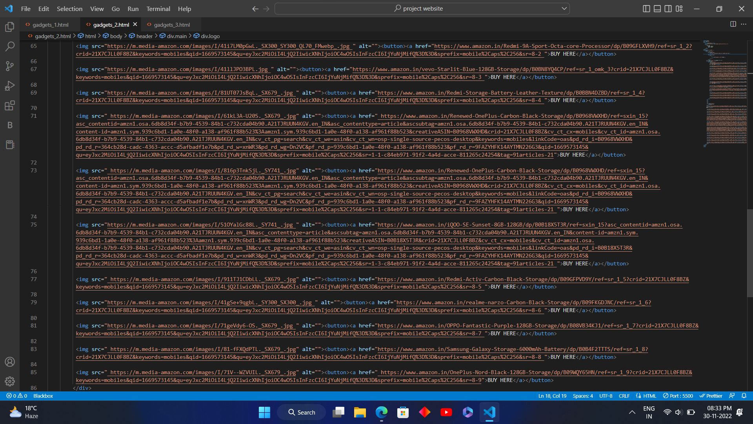
Source code of electronics webpage {html}

Slide 9
Source code of electronics webpage {html}

Slide 10
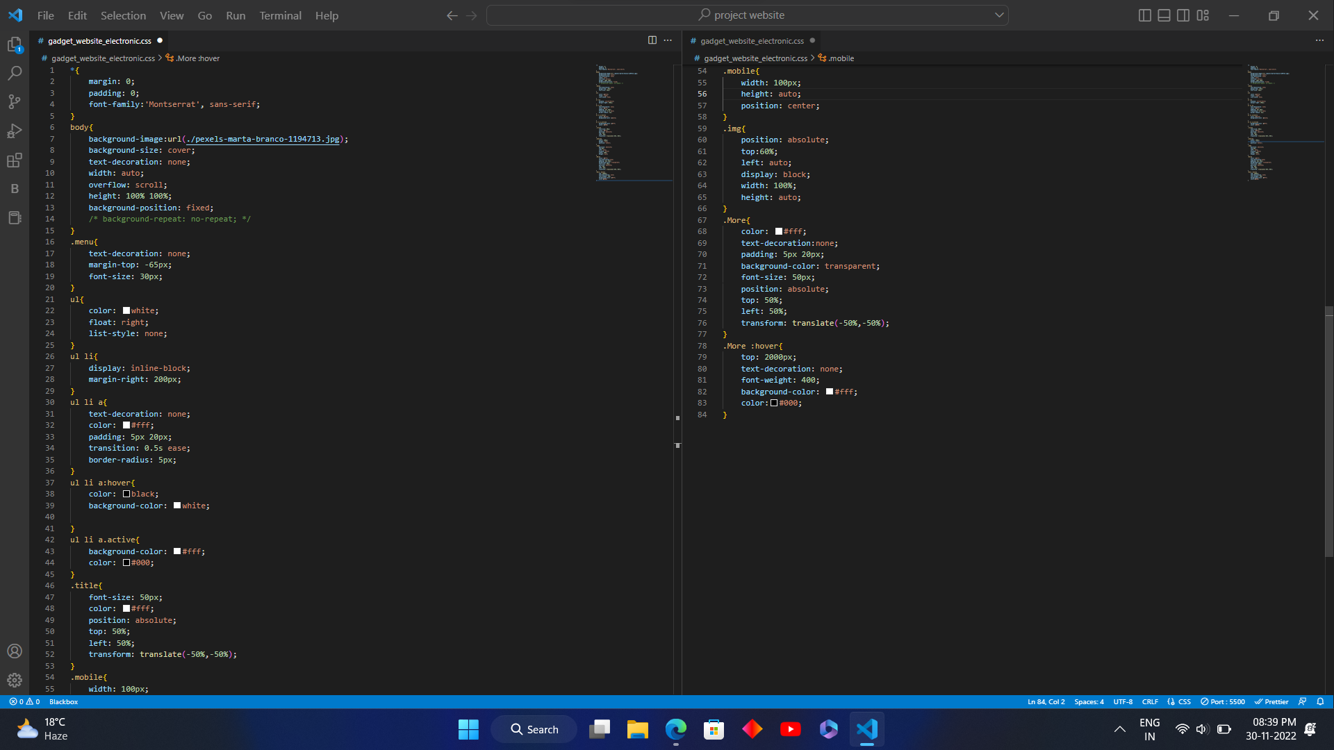
Source code of Electronics webpage { css }

Slide 11
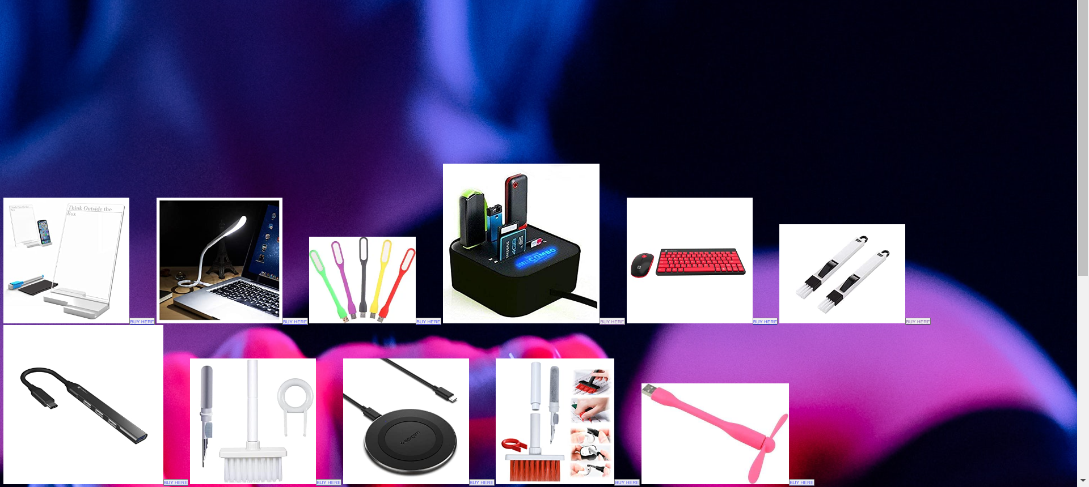
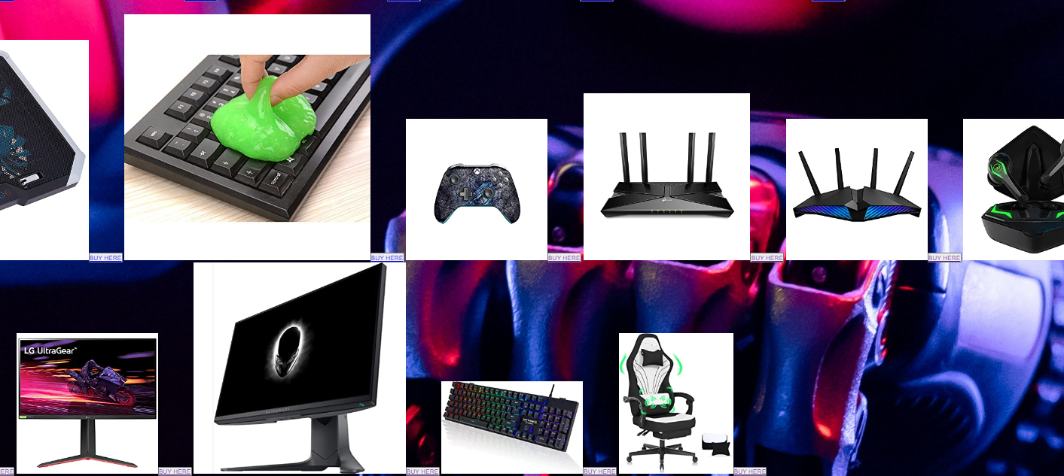
Gadgets
By clicking the Gadgets button on home page we visit the Gadgets webpage

Slide 12
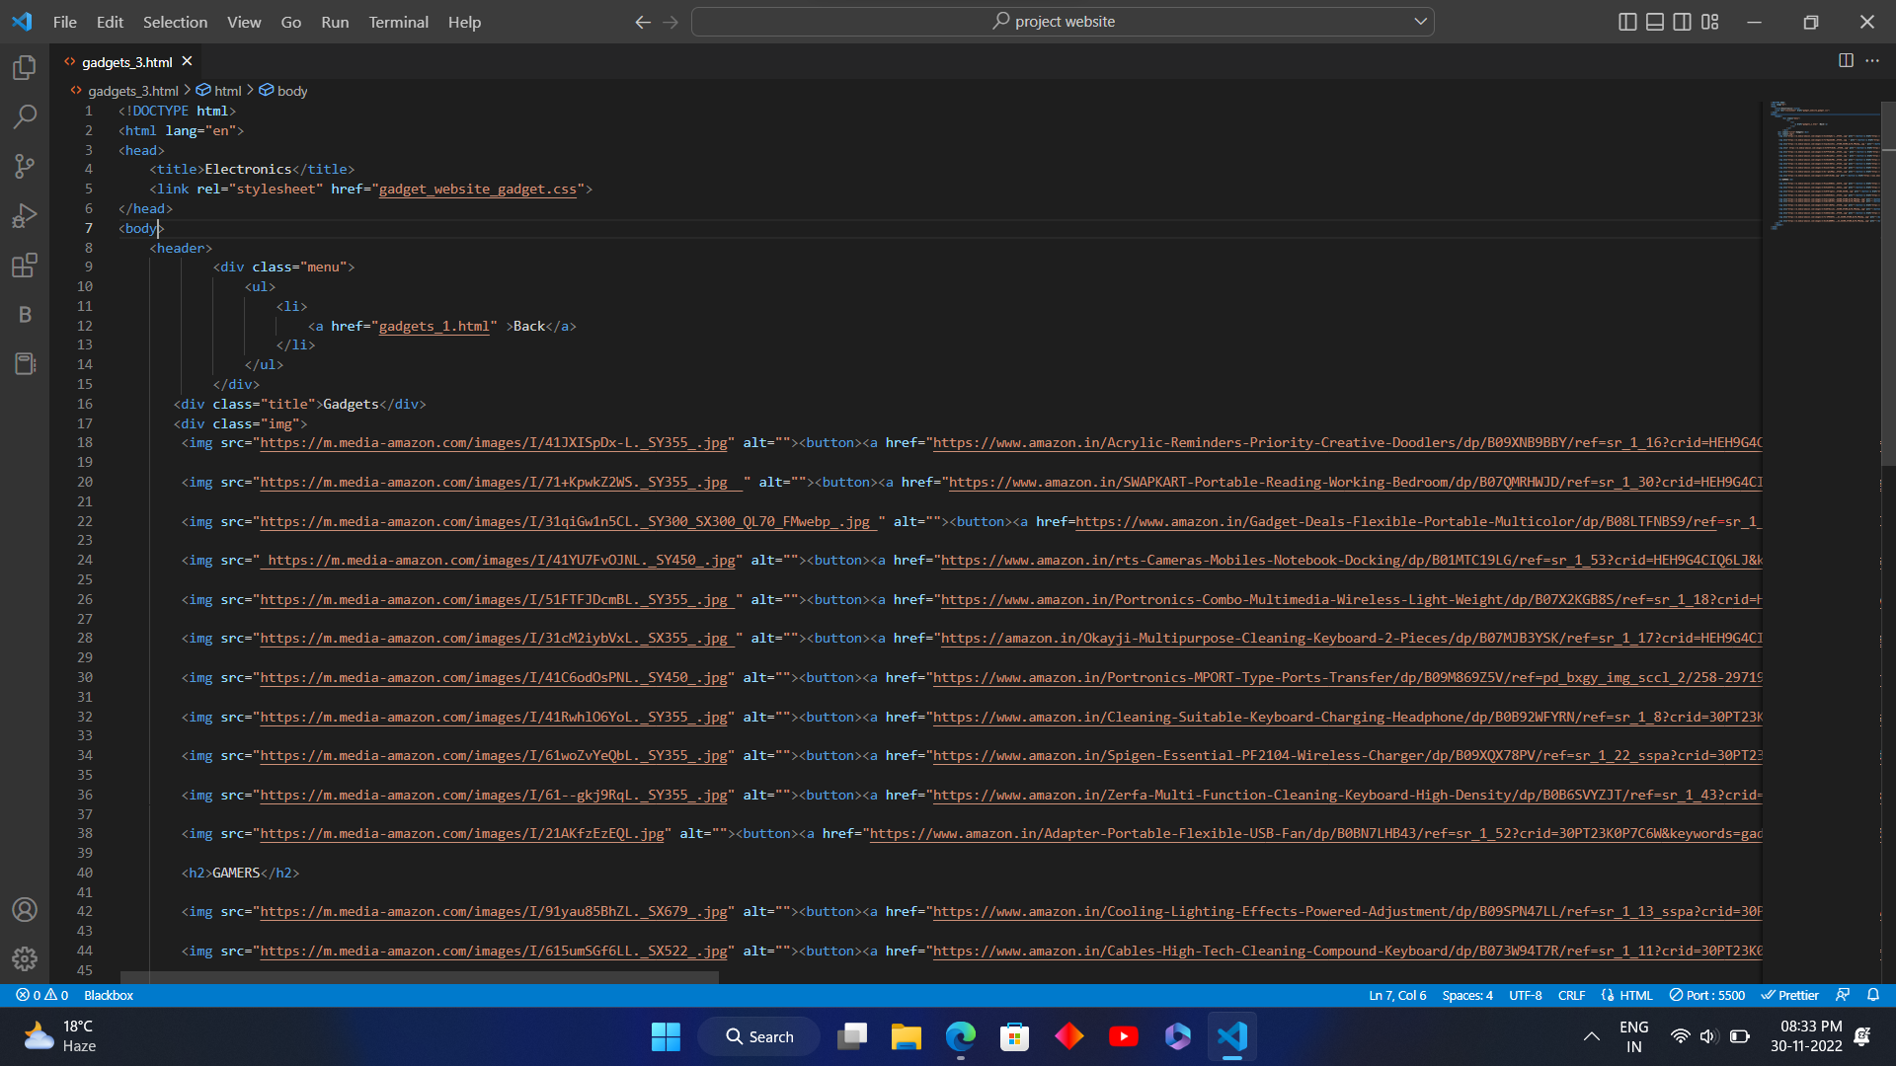
Source code gadget webpage {html 1}

Slide 13
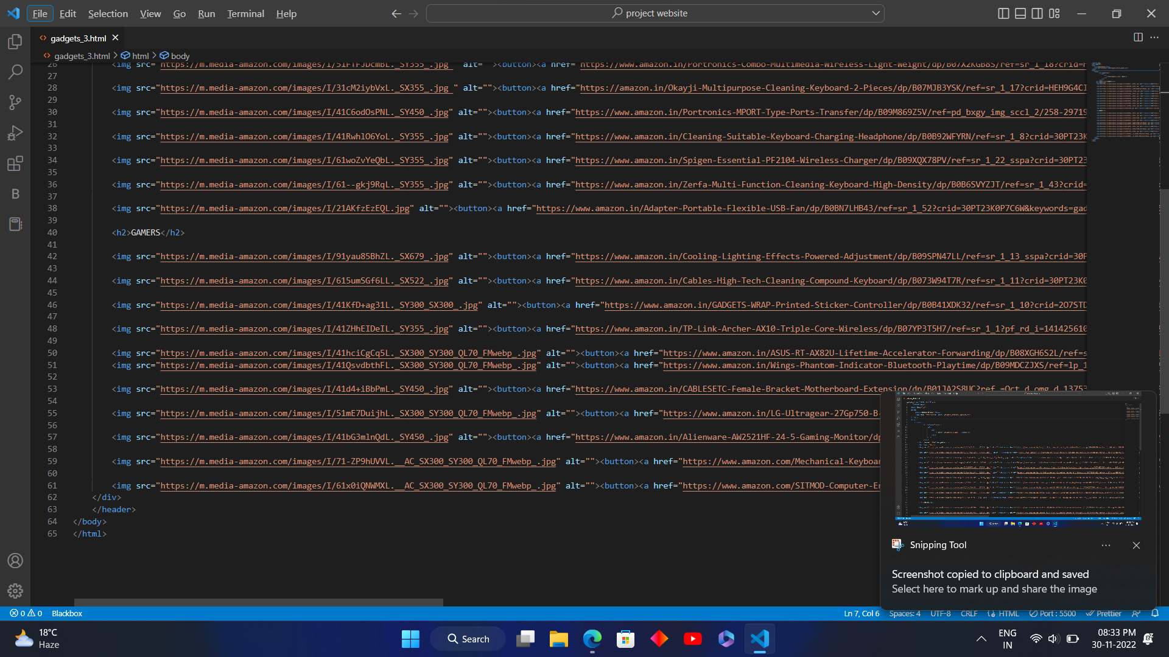
Source code of gadget webpage { html 2}

Slide 14
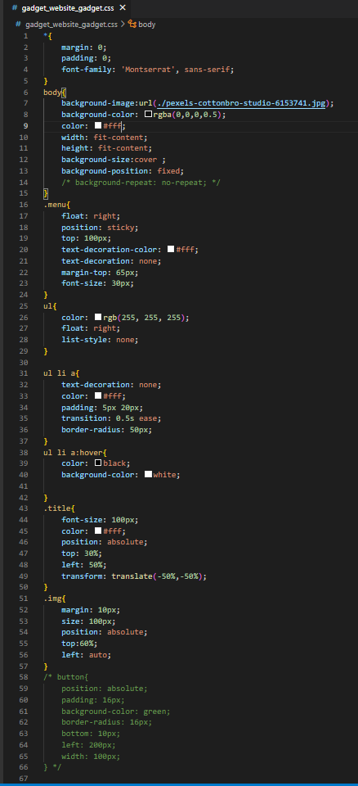
Source code of gadgets { css}

Slide 15

Contact US { CONTACT CARD}

Slide 16
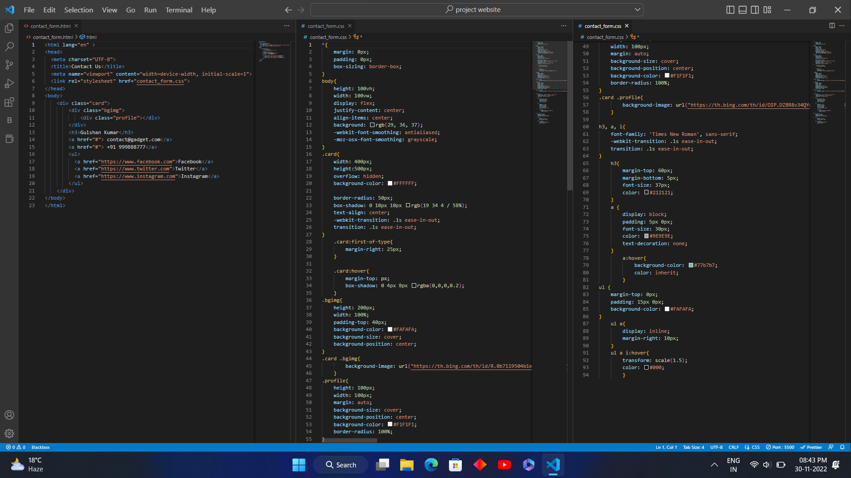
Soucre code of Contact US { Contact Card}

